Slide 1



Assembly Language for x86 Processors
6th Edition
Kip R. Irvine
Chapter 5: Procedures
Slides prepared by the author
Revision date: 2/15/2010
(c) Pearson Education, 2010. All rights reserved. You may modify and copy this slide show for your personal use, or for use in the classroom, as long as this copyright statement, the author's name, and the title are not changed.

Slide 2

Chapter Overview
Linking to an External Library
The Book's Link Library
Stack Operations
Defining and Using Procedures
Program Design Using Procedures

Slide 3

The Book's Link Library
Link Library Overview
Calling a Library Procedure
Linking to a Library
Library Procedures – Overview
Six Examples

Slide 4

Link Library Overview
A file containing procedures that have been compiled into machine code
constructed from one or more OBJ files
To build a library, . . .
start with one or more ASM source files
assemble each into an OBJ file
create an empty library file (extension .LIB)
add the OBJ file(s) to the library file, using the Microsoft LIB utility
Take a quick look at Irvine32.asm in the \Irvine\Examples\Lib32 folder.

Slide 5

Calling a Library Procedure
Call a library procedure using the CALL instruction. Some procedures require input arguments. The INCLUDE directive copies in the procedure prototypes (declarations).
The following example displays "1234" on the console:
INCLUDE Irvine32.inc
.code
mov eax,1234h | ; | input argument
call WriteHex | ; | show hex number
call Crlf | ; | end of line

Slide 6

Linking to a Library
Your programs link to Irvine32.lib using the linker command inside a batch file named make32.bat.
Notice the two LIB files: Irvine32.lib, and kernel32.lib
the latter is part of the Microsoft Win32 Software Development Kit (SDK)
Your program
links
Irvine32.lib
links | to
to
can link to
kernel32.lib
exe | cutes
kernel32.dll

Slide 7

What's Next
Linking to an External Library
The Book's Link Library
Stack Operations
Defining and Using Procedures
Program Design Using Procedures

Slide 8
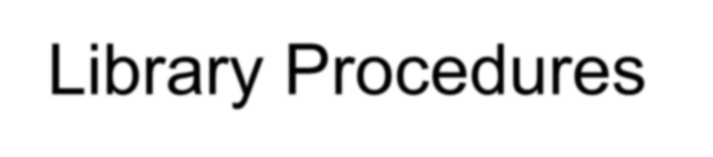
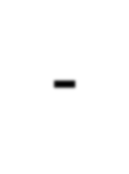

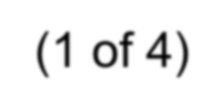
Library Procedures - Overview (1 of 4)
CloseFile – Closes an open disk file
Clrscr - Clears console, locates cursor at upper left corner
CreateOutputFile - Creates new disk file for writing in output mode Crlf - Writes end of line sequence to standard output
Delay - Pauses program execution for n millisecond interval DumpMem - Writes block of memory to standard output in hex
DumpRegs – Displays general-purpose registers and flags (hex) GetCommandtail - Copies command-line args into array of bytes GetDateTime – Gets the current date and time from the system GetMaxXY - Gets number of cols, rows in console window buffer GetMseconds - Returns milliseconds elapsed since midnight

Slide 9
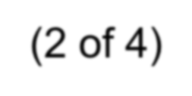
Library Procedures - Overview (2 of 4)
GetTextColor - Returns active foreground and background text colors in the console window
Gotoxy - Locates cursor at row and column on the console
IsDigit - Sets Zero flag if AL contains ASCII code for decimal digit (0–9)
MsgBox, MsgBoxAsk – Display popup message boxes OpenInputFile – Opens existing file for input ParseDecimal32 – Converts unsigned integer string to binary ParseInteger32 - Converts signed integer string to binary
Random32 - Generates 32-bit pseudorandom integer in the range 0 to FFFFFFFFh
Randomize - Seeds the random number generator
RandomRange - Generates a pseudorandom integer within a specified
range
ReadChar - Reads a single character from standard input

Slide 10
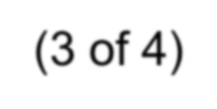
Library Procedures - Overview (3 of 4)
ReadDec - Reads 32-bit unsigned decimal integer from keyboard ReadFromFile – Reads input disk file into buffer
ReadHex - Reads 32-bit hexadecimal integer from keyboard
ReadInt - Reads 32-bit signed decimal integer from keyboard ReadKey – Reads character from keyboard input buffer
ReadString - Reads string from standard input, terminated by [Enter] SetTextColor - Sets foreground and background colors of all subsequent
console text output
Str_compare – Compares two strings
Str_copy – Copies a source string to a destination string StrLength – Returns length of a string
Str_trim - Removes unwanted characters from a string.

Slide 11
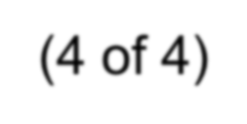
Library Procedures - Overview (4 of 4)
Str_ucase - Converts a string to uppercase letters.
WaitMsg - Displays message, waits for Enter key to be pressed WriteBin - Writes unsigned 32-bit integer in ASCII binary format. WriteBinB – Writes binary integer in byte, word, or doubleword format WriteChar - Writes a single character to standard output
WriteDec - Writes unsigned 32-bit integer in decimal format WriteHex - Writes an unsigned 32-bit integer in hexadecimal format
WriteHexB – Writes byte, word, or doubleword in hexadecimal format WriteInt - Writes signed 32-bit integer in decimal format

Slide 12
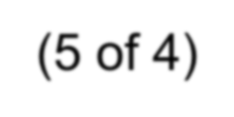
Library Procedures - Overview (5 of 4)
WriteStackFrame - Writes the current procedure’s stack frame to the console.
WriteStackFrameName - Writes the current procedure’s name and stack
frame to the console.
WriteString - Writes null-terminated string to console window WriteToFile - Writes buffer to output file
WriteWindowsMsg - Displays most recent error message generated by
MS-Windows

Slide 13
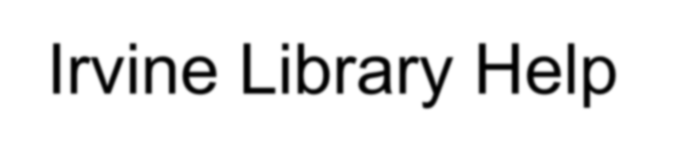
Irvine Library Help
A Windows help file showing:
Irvine Library Procedures Procedure Purpose
Calling & Return Arguments
Example of usage
Some other information (we will use later)
IrvineLibHelp.chm

Slide 14
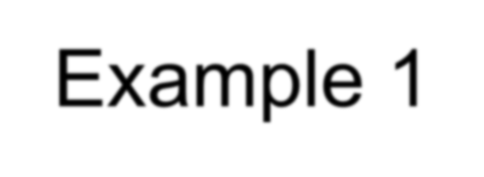
Example 1
Clear the screen, delay the program for 500 milliseconds, and dump the registers and flags.
.code
call Clrscr mov eax,500 call Delay call DumpRegs
Sample output:
EAX=00000613 EBX=00000000 ECX=000000FF EDX=00000000 ESI=00000000 EDI=00000100 EBP=0000091E ESP=000000F6 EIP=00401026 EFL=00000286 CF=0 SF=1 ZF=0 OF=0

Slide 15
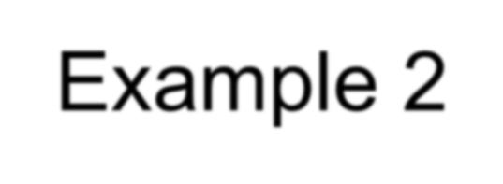
Example 2
Display a null-terminated string and move the cursor to the beginning of the next screen line.
.data
str1 BYTE "Assembly language is easy!",0
.code
mov edx,OFFSET str1 call WriteString call Crlf

Slide 16
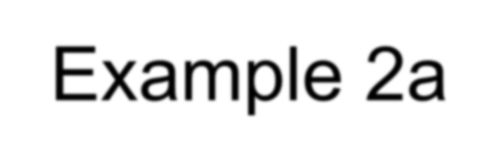
Example 2a
Display a null-terminated string and move the cursor to the beginning of the next screen line (use embedded CR/LF)
.data
str1 BYTE "Assembly language is easy!",0Dh,0Ah,0
.code
mov edx,OFFSET str1
call WriteString

Slide 17
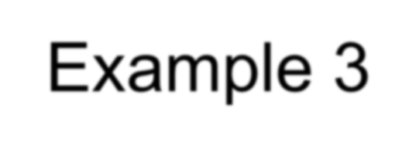
Example 3
Display an unsigned integer in binary, decimal, and hexadecimal, each on a separate line.
IntVal = 35
.code
mov | eax,IntVal
call | WriteBin | ; | display | binary
call | Crlf
call | WriteDec | ; | display | decimal
call | Crlf
call | WriteHex | ; | display | hexadecimal
call | Crlf
Sample output:
0000 0000 0000 0000 0000 0000 0010 0011
35
23

Slide 18
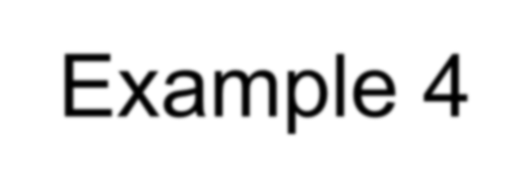
Example 4
Input a string from the user. EDX points to the string and ECX specifies the maximum number of characters the user is permitted to enter.
.data
fileName BYTE 80 DUP(0)
.code
mov edx,OFFSET fileName mov ecx,SIZEOF fileName – 1 call ReadString
A null byte is automatically appended to the string.

Slide 19
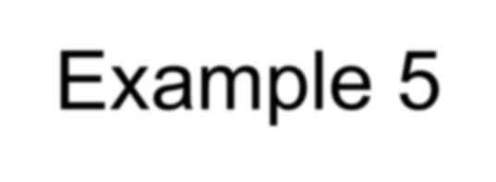
Example 5
Generate and display ten pseudorandom signed integers in the range 0 – 99. Pass each integer to WriteInt in EAX and display it on a separate line.
.code
mov ecx,10
; loop counter
L1: mov | eax,100 | ; | ceiling value
call | RandomRange | ; | generate random int
call | WriteInt | ; | display signed int
call | Crlf | ; | goto next display line
loop | L1 | ; | repeat loop

Slide 20
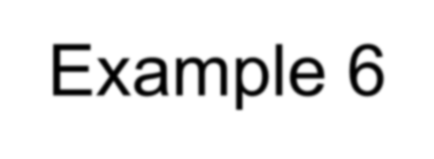
Example 6
Display a null-terminated string with yellow characters on a blue background.
.data
str1 BYTE "Color output is easy!",0
.code
mov eax,yellow + (blue * 16) call SetTextColor
mov edx,OFFSET str1 call WriteString call Crlf
The background color is multiplied by 16 before being added to the foreground color.

Slide 21
What's Next
Linking to an External Library
The Book's Link Library
Stack Operations
Defining and Using Procedures
Program Design Using Procedures

Slide 22
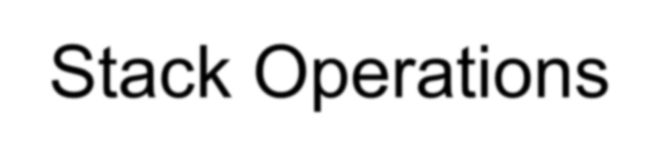
Stack Operations
Runtime Stack
PUSH Operation
POP Operation
PUSH and POP Instructions
Using PUSH and POP
Example: Reversing a String
Related Instructions

Slide 23
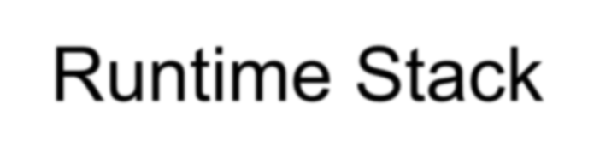


Runtime Stack
Imagine a stack of plates . . .
plates are only added to the top
plates are only removed from the top
LIFO structure
10
9
8
7
6
5
4
3
2
1
top
bottom

Slide 24
Runtime Stack
Managed by the CPU, using two registers
SS (stack segment)
ESP (stack pointer) *
Offset
00001000 00000006
ESP
00000FFC
00000FF8
00000FF4
00000FF0
* SP in Real-address mode

Slide 25

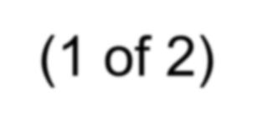
PUSH Operation (1 of 2)
A 32-bit push operation decrements the stack pointer by 4 and copies a value into the location pointed to by the stack pointer.
BEFORE
AFTER
00001000 00000006
00000FFC 000000A5
00001000
00000006
ESP
00000FFC
ESP
00000FF8
00000FF8
00000FF4
00000FF4
00000FF0
00000FF0

Slide 26
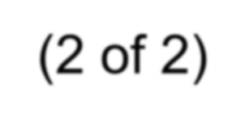
PUSH Operation (2 of 2)
Same stack after pushing two more integers:
Offset
00001000
00000006
00000FFC
000000A5
00000FF8
00000001
00000FF4
00000002
ESP
00000FF0
The stack grows downward. The area below ESP is always available (unless the stack has overflowed).

Slide 27

POP Operation
Copies value at stack[ESP] into a register or variable.
Adds n to ESP, where n is either 2 or 4.
value of n depends on the attribute of the operand receiving the
data
BEFORE
AFTER
00001000 00000006
00001000 00000006
00000FFC 000000A5
00000FFC 000000A5
00000FF8 00000001
00000FF8 00000001
ESP
00000FF4 00000002
ESP
00000FF4
00000FF0
00000FF0

Slide 28

PUSH and POP Instructions
PUSH syntax:
PUSH r/m16
PUSH r/m32
PUSH imm32
POP syntax:
POP r/m16
POP r/m32

Slide 29

Using PUSH and POP
Save and restore registers when they contain important values. PUSH and POP instructions occur in the opposite order.
push push push mov | esi ecx ebx esi,OFFSET dwordVal | ; ; | push registers display some memory
mov mov call | ecx,LENGTHOF dwordVal ebx,TYPE dwordVal DumpMem
pop pop pop | ebx ecx esi | ; | restore registers

Slide 30
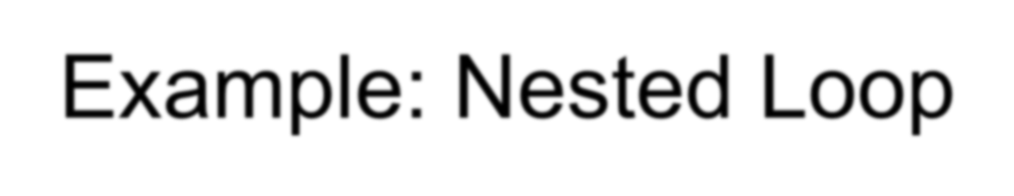
Example: Nested Loop
When creating a nested loop, push the outer loop counter before entering the inner loop:
mov ecx,100
; set outer loop count
; begin the outer loop
; save outer loop count
L1:
push ecx
mov ecx,20
; set inner loop count
; begin the inner loop
L2:
;
;
loop L2 ; repeat the inner loop
pop ecx loop L1
; restore outer loop count
; repeat the outer loop

Slide 31
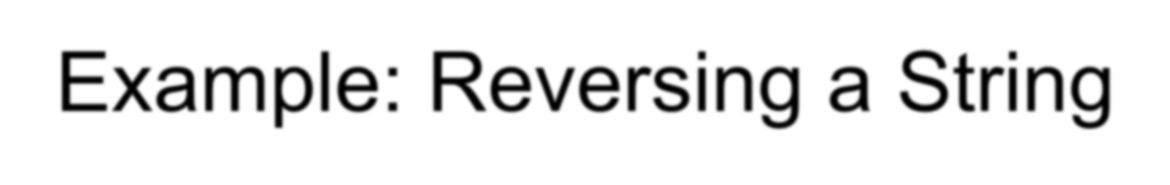
Example: Reversing a String
Use a loop with indexed addressing
Push each character on the stack
Start at the beginning of the string, pop the stack in reverse
order, insert each character back into the string
Source code
Q: Why must each character be put in EAX before it is pushed?
Because only word (16-bit) or doubleword (32-bit) values can be pushed on the stack.

Slide 32
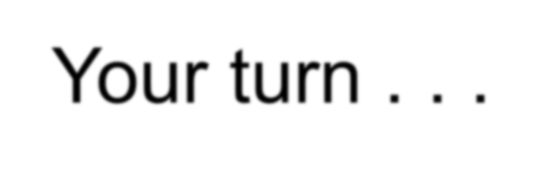
Your turn . . .
Using the String Reverse program as a starting point,
#1: Modify the program so the user can input a string containing between 1 and 50 characters.
#2: Modify the program so it inputs a list of 32-bit integers from the user, and then displays the integers in reverse order.

Slide 33

Related Instructions
PUSHFD and POPFD
push and pop the EFLAGS register
PUSHAD pushes the 32-bit general-purpose registers on the stack
order: EAX, ECX, EDX, EBX, ESP, EBP, ESI, EDI
POPAD pops the same registers off the stack in
reverse order
PUSHA and POPA do the same for 16-bit registers

Slide 34
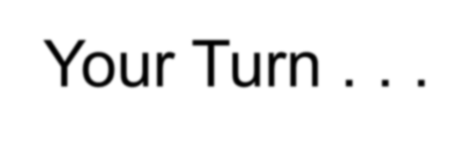
Your Turn . . .
Write a program that does the following:
Assigns integer values to EAX, EBX, ECX, EDX, ESI, and EDI
Uses PUSHAD to push the general-purpose registers on the stack
Using a loop, your program should pop each integer
from the stack and display it on the screen

Slide 35
What's Next
Linking to an External Library
The Book's Link Library
Stack Operations
Defining and Using Procedures
Program Design Using Procedures

Slide 36

Defining and Using Procedures
Creating Procedures
Documenting Procedures
Example: SumOf Procedure
CALL and RET Instructions
Nested Procedure Calls
Local and Global Labels
Procedure Parameters
Flowchart Symbols
USES Operator

Slide 37

Creating Procedures
Large problems can be divided into smaller tasks to make them more manageable
A procedure is the ASM equivalent of a Java or C++
function
Following is an assembly language procedure named sample:
sample PROC
.
.
ret sample ENDP

Slide 38

Documenting Procedures
Suggested documentation for each procedure:
A description of all tasks accomplished by the procedure.
Receives: A list of input parameters; state their usage and requirements.
Returns: A description of values returned by the procedure.
Requires: Optional list of requirements called preconditions that must be satisfied before the procedure is called.
If a procedure is called without its preconditions satisfied, it will
probably not produce the expected output.

Slide 39
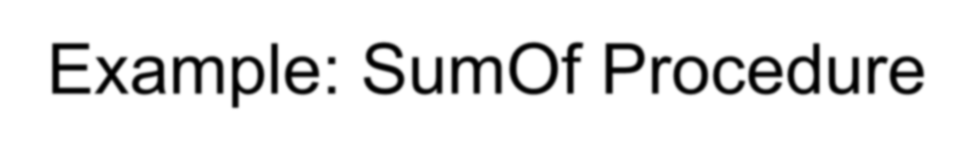
Example: SumOf Procedure
; SumOf PROC
;
; Calculates and returns the sum of three 32-bit integers.
; Receives: EAX, EBX, ECX, the three integers. May be
; signed or unsigned.
; Returns: EAX = sum, and the status flags (Carry,
; Overflow, etc.) are changed.
; Requires: nothing
; add eax,ebx
add eax,ecx ret
SumOf ENDP

Slide 40

CALL and RET Instructions
The CALL instruction calls a procedure
pushes offset of next instruction on the stack
copies the address of the called procedure into EIP
The RET instruction returns from a procedure
pops top of stack into EIP

Slide 41
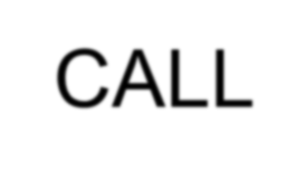
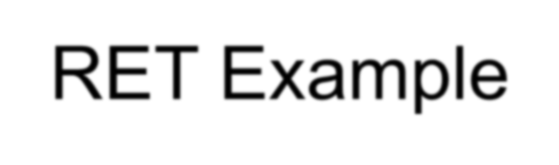

CALL-RET Example (1 of 2)
main PROC
00000020 call MySub
00000025 mov eax,ebx
.
.
main ENDP
MySub PROC
00000040 mov eax,edx
.
.
ret MySub ENDP
0000025 is the offset of the instruction immediately following the CALL instruction
00000040 is the offset of the first instruction inside MySub

Slide 42

CALL-RET Example (2 of 2)
00000025
ESP
00000040
The CALL instruction pushes 00000025 onto the stack, and loads 00000040 into EIP
EIP
The RET instruction pops 00000025 from the stack into EIP
00000025
ESP
00000025
EIP
(stack shown before RET executes)

Slide 43
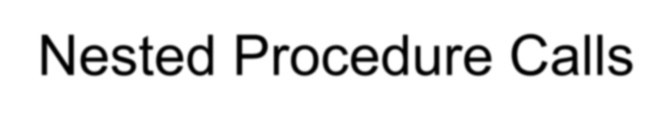
Nested Procedure Calls
main PROC
.
.
call Sub1 exit
main ENDP
Sub1 PROC
.
.
call Sub2 ret
Sub1 ENDP
Sub2 PROC
.
.
call Sub3 ret
Sub2 ENDP
Sub3 PROC
.
.
ret Sub3 ENDP
By the time Sub3 is called, the stack contains all three return addresses:
(ret to main)
(ret to Sub1) (ret to Sub2)
ESP

Slide 44
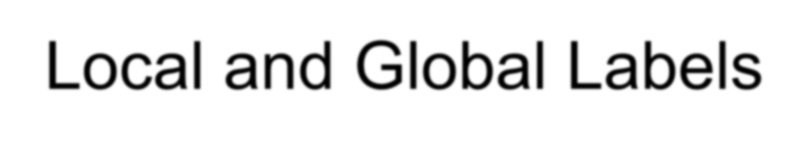
Local and Global Labels
A local label is visible only to statements inside the same procedure. A global label is visible everywhere.
main PROC
jmp L2 | ; | error
L1:: | ; | global | label
exit
main ENDP
sub2 PROC L2:
jmp L1 ret
sub2 ENDP
; local label
; ok

Slide 45

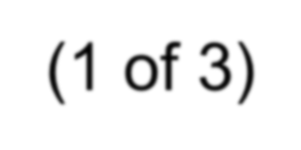
Procedure Parameters (1 of 3)
A good procedure might be usable in many different programs
but not if it refers to specific variable names
Parameters help to make procedures flexible because parameter values can change at runtime

Slide 46
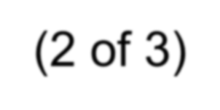
Procedure Parameters (2 of 3)
The ArraySum procedure calculates the sum of an array. It makes two references to specific variable names:
ArraySum PROC
mov | esi,0 |  | ; | array index
mov | eax,0 |  | ; | set the sum to zero
mov | ecx,LENGTHOF | myarray | ; | set number of elements
L1: add eax,myArray[esi] add esi,4
loop L1
; add each integer to sum
; point to next integer
; repeat for array size
mov theSum,eax ret
ArraySum ENDP
; store the sum
What if you wanted to calculate the sum of two or three arrays within the same program?

Slide 47
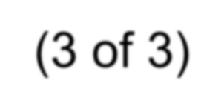
Procedure Parameters (3 of 3)
This version of ArraySum returns the sum of any doubleword array whose address is in ESI. The sum is returned in EAX:
ArraySum PROC
; Receives: ESI points to an array of doublewords,
; ECX = number of array elements.
; Returns: EAX = sum
; mov eax,0 ; set the sum to zero
L1: add eax,[esi] add esi,4 loop L1
; add each integer to sum
; point to next integer
; repeat for array size
ret
ArraySum ENDP

Slide 48

Flowchart Symbols
The following symbols are the basic building blocks of flowcharts:
begin / end
manual input
process (task)
display
 | procedure call
decision
yes
no
(Includes two symbols not listed on page 166 of the book.)

Slide 49
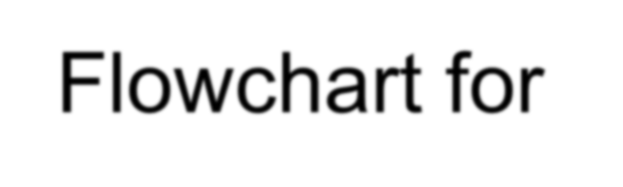


ArraySum Procedure
begin push esi, ecx
eax = 0
AS1:
add eax,[esi]
add esi, 4 ecx = ecx − 1
^{yes} ecx > 0?
no
pop ecx, esi
end
Flowchart for the ArraySum Procedure
push esi push ecx mov eax,0
AS1:
add eax,[esi] add esi,4 loop AS1
pop ecx
pop esi

Slide 50
Your turn . . .
Draw a flowchart that expresses the following pseudocode:
input exam grade from the user if( grade > 70 )
display "Pass"
else
display "Fail" endif

Slide 51
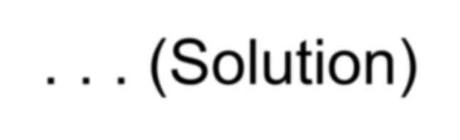

. . . (Solution)
begin
input exam grade
no
yes
grade > 70?
display "Fail"
display "Pass"
end

Slide 52
Your turn . . .
Modify the flowchart in the previous slide to allow the user to continue to input exam scores until a value of
–1 is entered

Slide 53

USES Operator
Lists the registers that will be preserved
ArraySum PROC USES esi ecx mov eax,0
etc.
; set the sum to zero
MASM generates the code shown in gold:
ArraySum PROC push esi push ecx
.
.
pop ecx pop esi ret
ArraySum ENDP

Slide 54
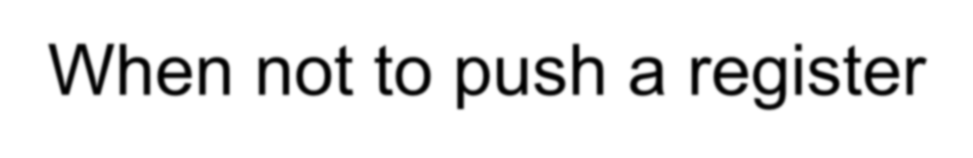
When not to push a register
The sum of the three registers is stored in EAX on line (3), but the POP instruction replaces it with the starting value of EAX on line (4):
SumOf PROC | ; | sum of three integers
push eax | ; | 1
add eax,ebx | ; | 2
add eax,ecx | ; | 3
pop eax | ; | 4
ret
SumOf ENDP

Slide 55
What's Next
Linking to an External Library
The Book's Link Library
Stack Operations
Defining and Using Procedures
Program Design Using Procedures

Slide 56

Program Design Using Procedures
Top-Down Design (functional decomposition) involves
the following:
design your program before starting to code
break large tasks into smaller ones
use a hierarchical structure based on procedure calls
test individual procedures separately

Slide 57

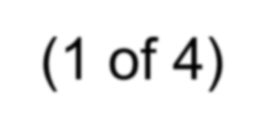
Integer Summation Program (1 of 4)
Description: Write a program that prompts the user for multiple 32-bit integers, stores them in an array, calculates the sum of the array, and displays the sum on the screen.
Main steps:
Prompt user for multiple integers
Calculate the sum of the array
Display the sum

Slide 58
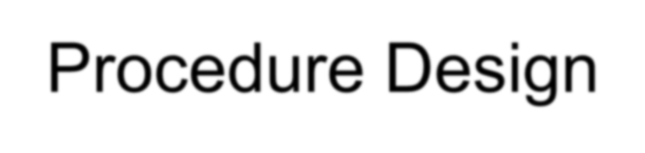
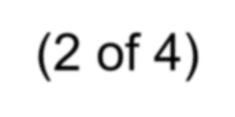
Procedure Design (2 of 4)
Main
Clrscr PromptForIntegers
WriteString
ReadInt ArraySum DisplaySum
WriteString WriteInt
; clear screen
; display string
; input integer
; sum the integers
; display string
; display integer

Slide 59
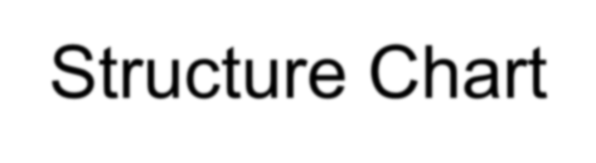
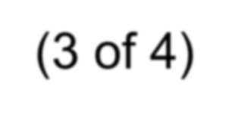
Structure Chart (3 of 4)
Summation Program (main)
Clrscr
PromptForIntegers
ArraySum
DisplaySum
WriteString
ReadInt
WriteString
WriteInt
WriteInt
View the stub program
View the final program
gray indicates library procedure

Slide 60
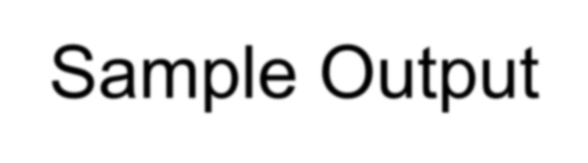

Sample Output (4 of 4)
Enter | a | signed | integer: | 550
Enter | a | signed | integer: | -23
Enter | a | signed | integer: | -96
The sum of the integers is: +431

Slide 61
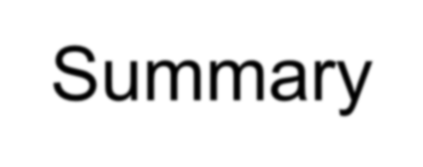
Summary
Procedure – named block of executable code
Runtime stack – LIFO structure
holds return addresses, parameters, local variables
PUSH – add value to stack
POP – remove value from stack
Use the Irvine32 library for all standard I/O and data
conversion
Want to learn more? Study the library source code in the c:\Irvine\Examples\Lib32 folder

Slide 62

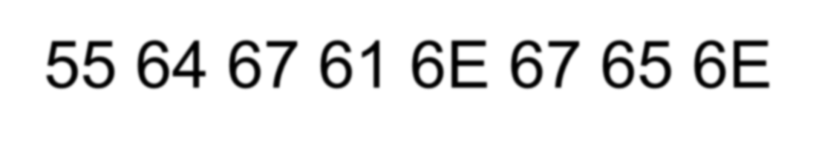
55 64 67 61 6E 67 65 6E

